Slide 1
Relational Database

Slide 2
Relational Model
Tables, Columns and Rows
Relationships and Keys
Data Integrity
Normalization

Slide 3
Relational Model
Salient features of a relational table
  Values are atomic. A special null value is used to represent
  values that are unknown or inapplicable to certain tuples.
  Column values are of the same kind (Domain)
  Each Row is unique
  Sequence of columns is insignificant
  Sequence of rows is insignificant
  Each column must have a unique name
  Relationships and Keys
    Keys - Fundamental to the concept of relational databases
    Relationship - An association between two or more tables defined by means of keys

Slide 4
CHARACTERISTICS OF RELATIONS
Notation:
  We refer to component values of a tuple t by t[A_{i}] = v_{i} (the value of attribute A_{i} for tuple t).
  Similarly, t[A_{u}, A_{v}, ..., A_{w}] refers to the subtuple of t containing the values of attributes A_{u}, A_{v}, ..., A_{w}, respectively.

Slide 5
Relational Integrity Constraints
Constraints are conditions that must hold on all valid relation instances. There are three main types of constraints:
  Key constraints
  Entity integrity constraints
  Referential integrity constraints

Slide 6
Keys
Let K ⊆ R
K is a superkey of R if values for K are sufficient to identify a unique tuple of each possible relation r(R)
  by “possible r ” we mean a relation r that could exist in the enterprise we are modeling.
  Example: {customer_name, customer_street} and
  {customer_name}
  are both superkeys of Customer, if no two customers can possibly have the same name
    In real life, an attribute such as customer_id would be used instead of customer_name to uniquely identify customers, but we omit it to keep our examples small, and instead assume customer names are unique.

Slide 7
Keys (Cont.)
K is a candidate key if K is minimal
Example: {customer_name} is a candidate key for Customer, since it is a superkey and no subset of it is a superkey.
Primary key: a candidate key chosen as the principal means of identifying tuples within a relation
  Should choose an attribute whose value never, or very rarely, changes.
  E.g. email address is unique, but may change

Slide 8
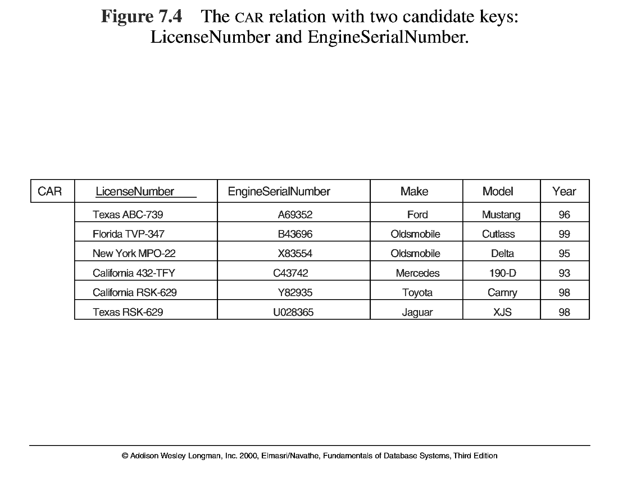
Key Constraints

Slide 9
Entity Integrity
Relational Database Schema: A set S of relation schemas that belong to the same database. S is the name of the database.
S = {R₁, R₂, ..., R_{n}}
Entity Integrity: The primary key attributes PK of each relation schema R in S cannot have null values in any tuple of r(R). This is because primary key values are used to identify the individual tuples.
t[PK] ≠ null for any tuple t in r(R)
Note: Other attributes of R may be similarly constrained to disallow null values, even though they are not members of the primary key.

Slide 10
Referential Integrity
A constraint involving two relations.
Used to specify a relationship among tuples in two relations: the referencing relation and the referenced relation.
Tuples in the referencing relation R₁ have attributes FK (called foreign key attributes) that reference the primary key attributes PK of the referenced relation R₂. A tuple t₁ in R₁ is said to reference a tuple t₂ in R₂ if t₁[FK] = t₂[PK].
A referential integrity constraint can be displayed in a relational database schema as a directed arc from R₁.FK to R₂.PK

Slide 11
Referential Integrity Constraint
Statement of the constraint
The value in the foreign key column (or columns) FK of the the referencing relation R₁ can be either:
(1) a value of an existing primary key value of the
corresponding primary key PK in the referenced
relation R_{2,}, or..
(2) a null.
In case (2), the FK in R₁ should not be a part of its own primary key.

Slide 12

Foreign Keys
A relation schema may have an attribute that corresponds to the primary key of another relation. The attribute is called a foreign key.
  E.g. customer_name and account_number attributes of depositor are foreign keys to customer and account respectively.
  Only values occurring in the primary key attribute of the referenced relation may occur in the foreign key attribute of the referencing relation.
Schema diagram

Slide 13
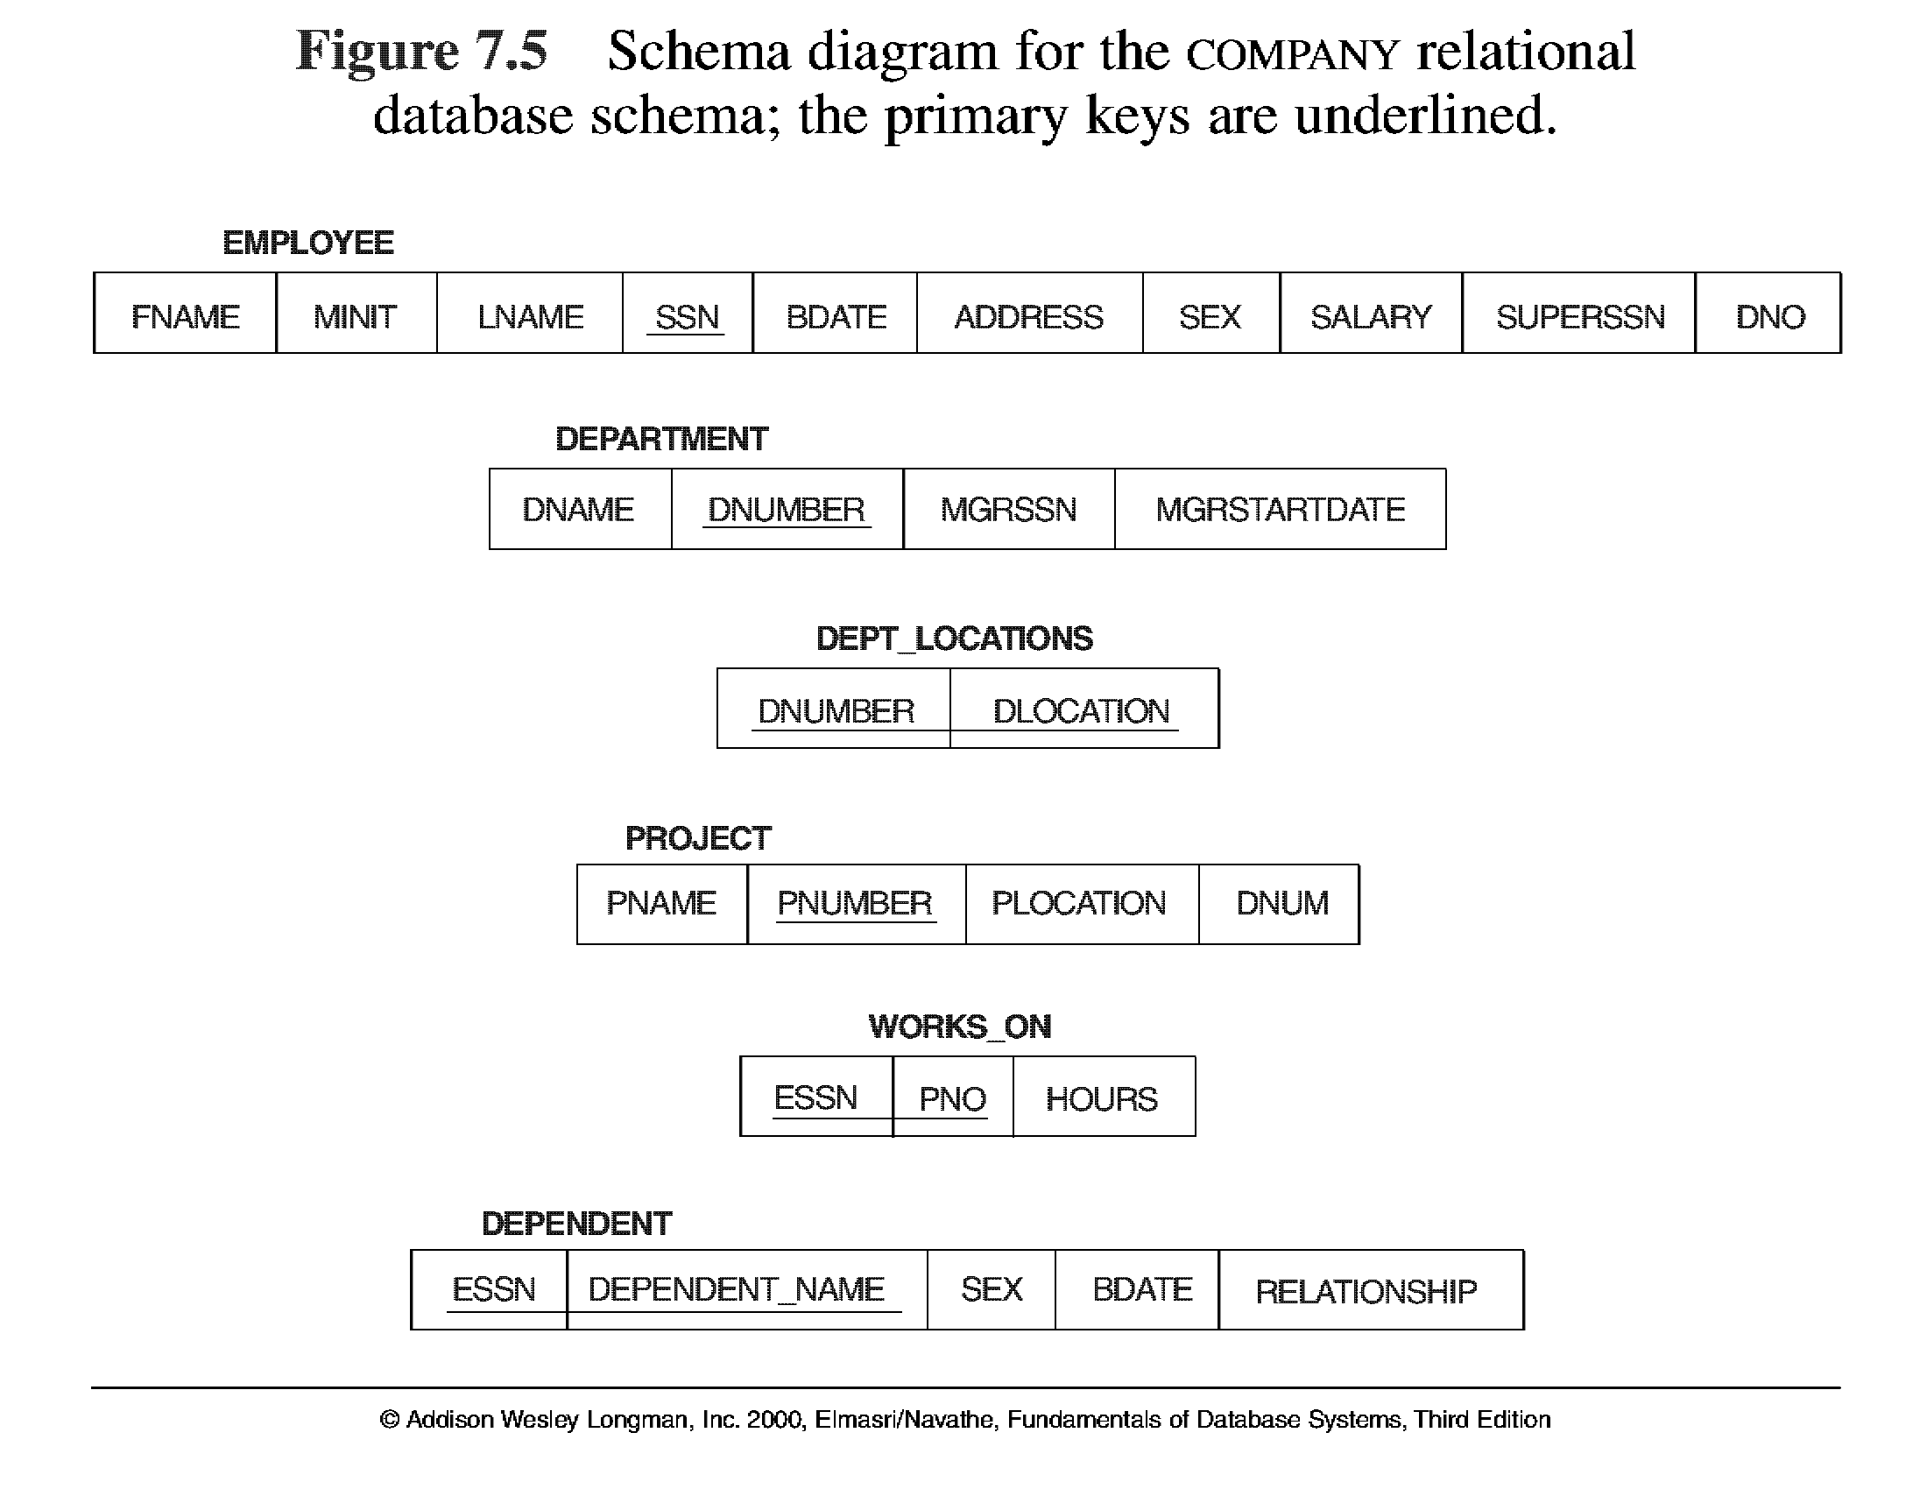

Slide 14
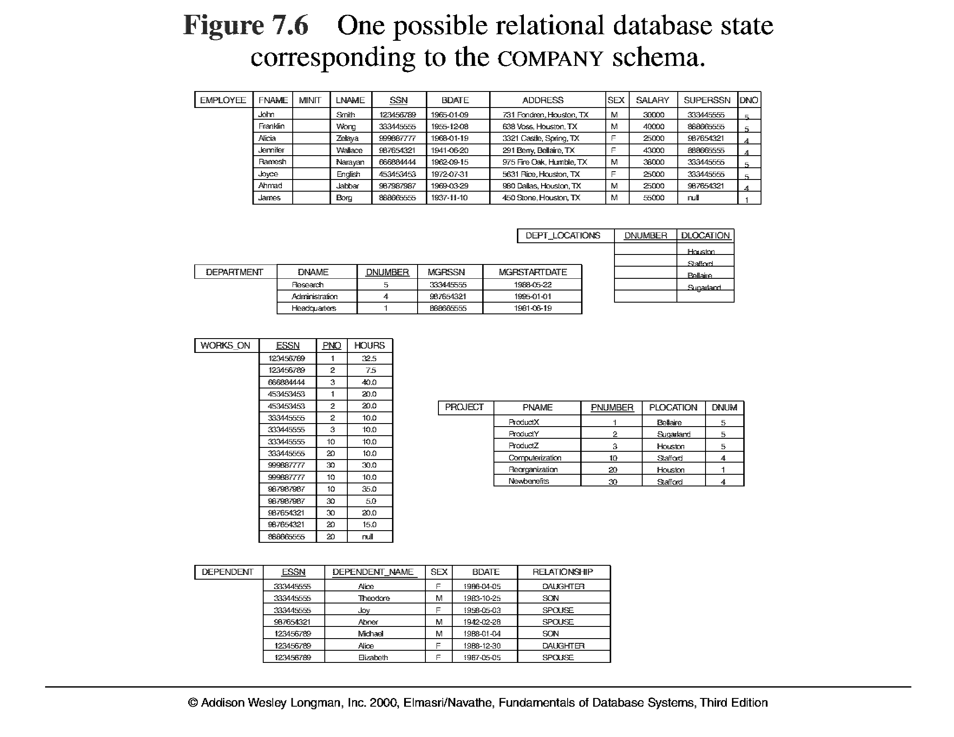

Slide 15
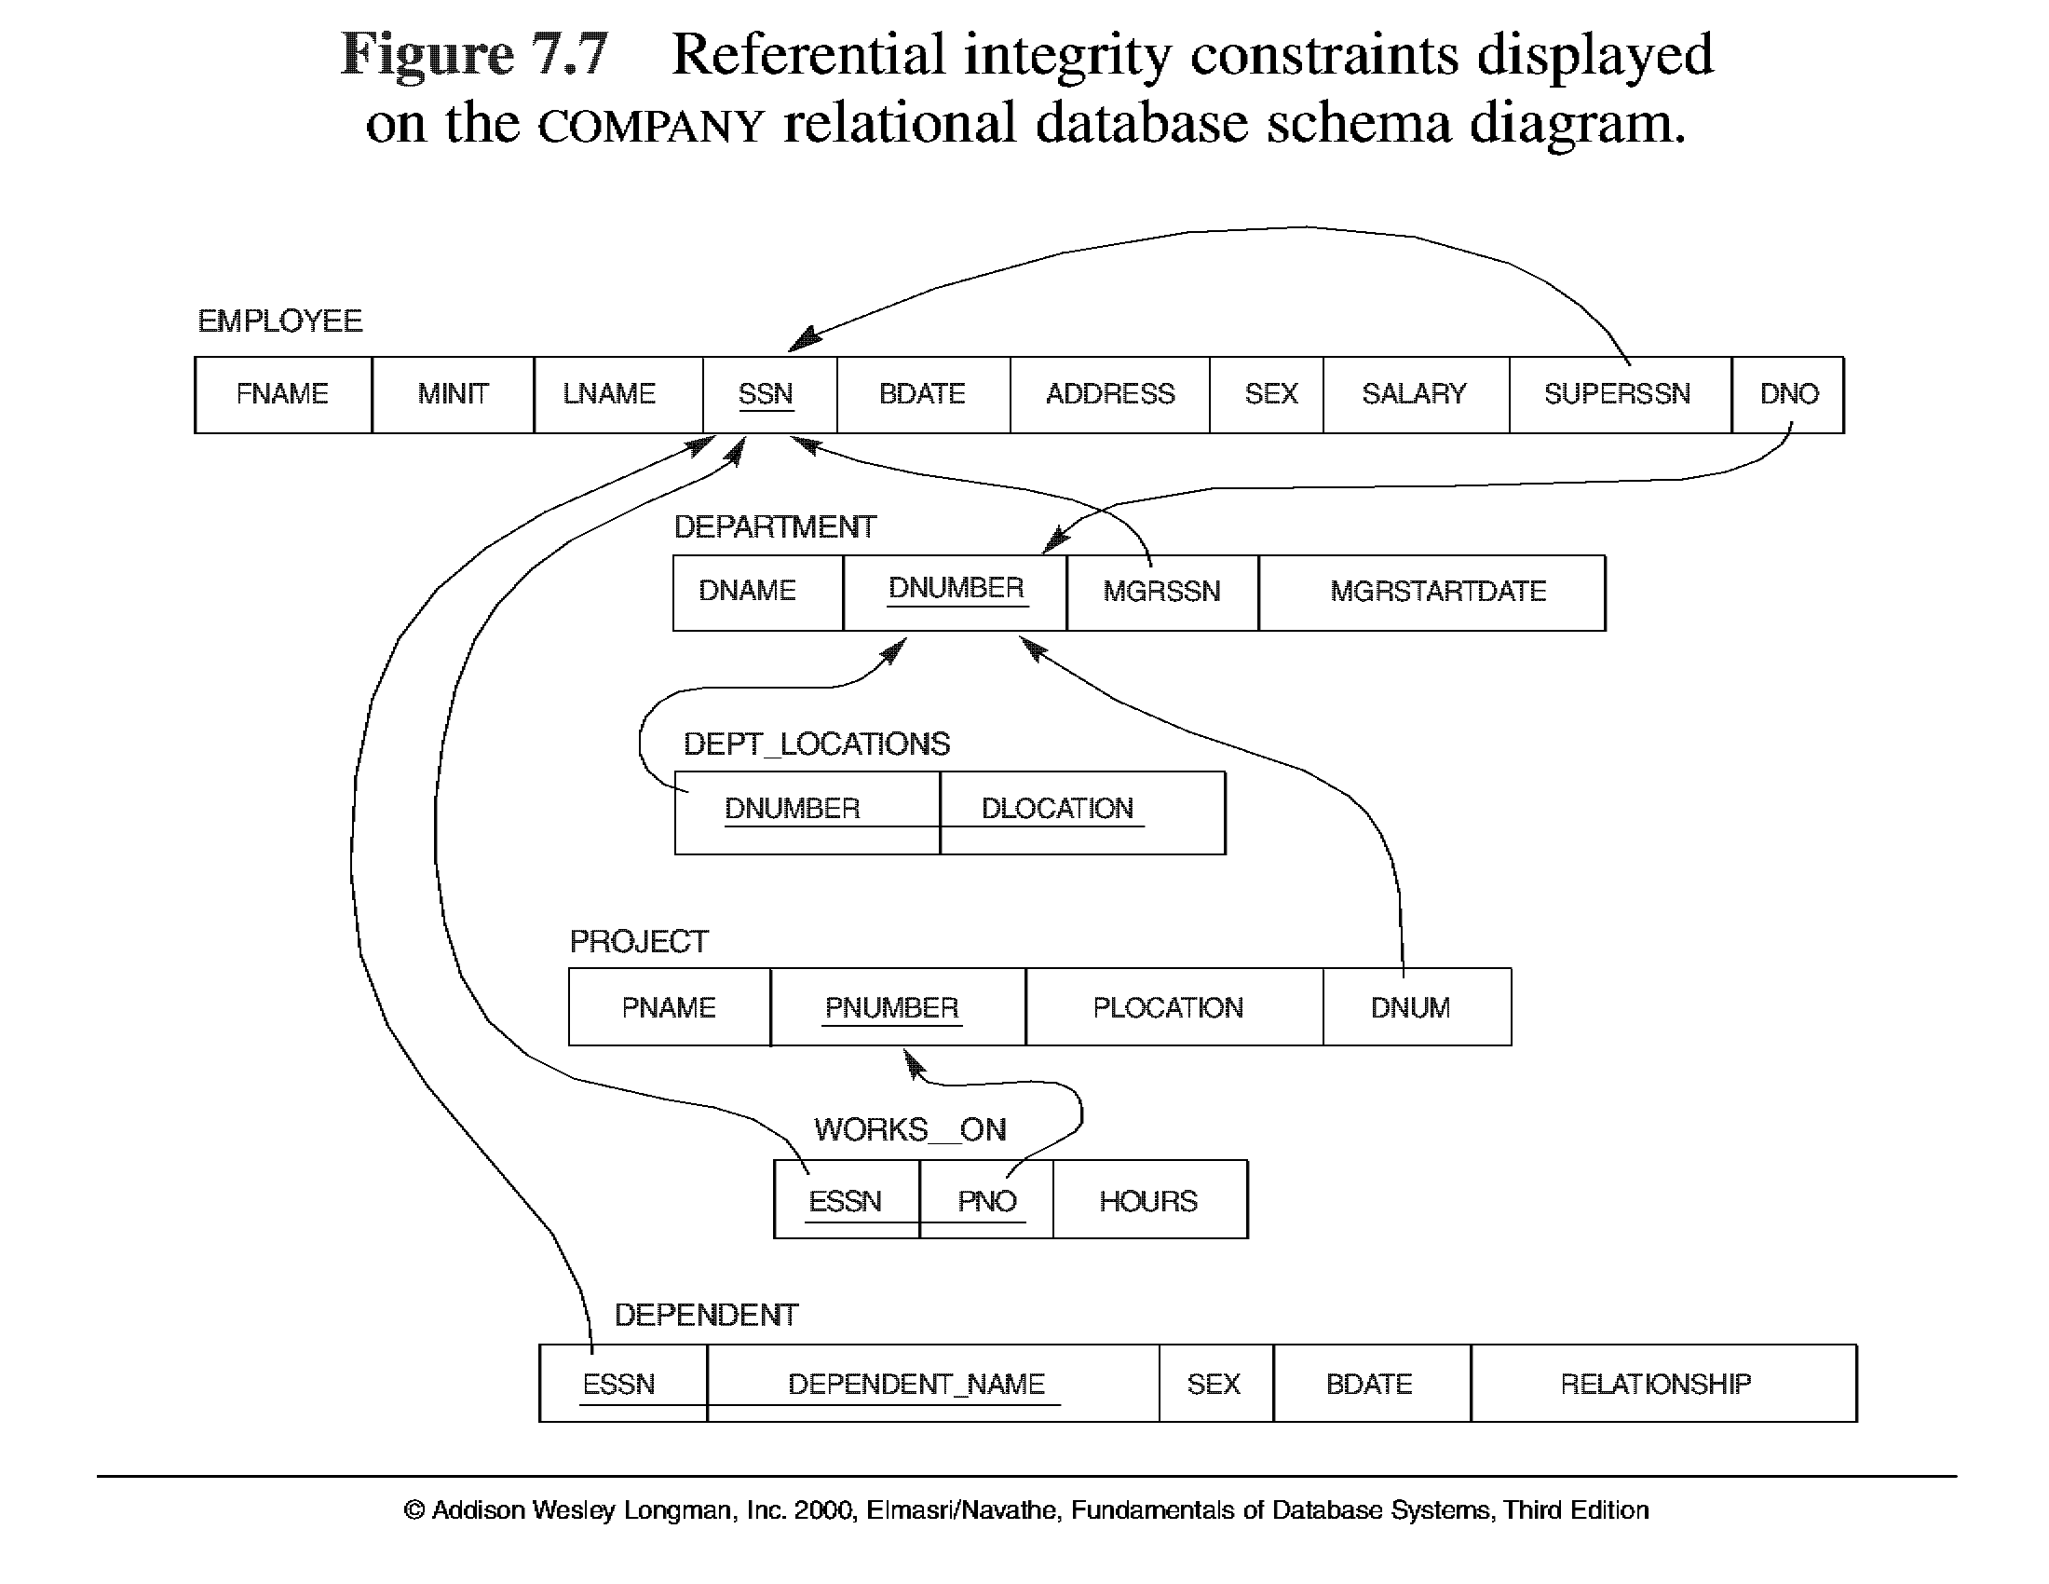

Slide 16
Relational Model
Data Manipulation
  Relational tables are equivalent to sets
  Operations that can be performed on sets can be performed on relational tables
  Relational Operations such as :
    Selection
    Projection
    Join
    Union
    Intersection
    Difference
    Product
    Division
INTERSECTION
UNION
DIFFERENCE

Slide 17
Query Languages
Language in which user requests information from the database.
Categories of languages
  Procedural
  Non-procedural, or declarative
“Pure” languages:
  Relational algebra
  Tuple relational calculus
  Domain relational calculus
Pure languages form underlying basis of query languages that people use.

Slide 18
Relational Algebra
The basic set of operations for the relational model is known as the relational algebra. These operations enable a user to specify basic retrieval requests.
The result of a retrieval is a new relation, which may have been formed from one or more relations. The algebra operations thus produce new relations, which can be further manipulated using operations of the same algebra.
A sequence of relational algebra operations forms a relational algebra expression, whose result will also be a relation that represents the result of a database query (or retrieval request).

Slide 19
Relational Algebra
Procedural language
Six basic operators
  select: σ
  project: ∏
  union: ∪
  set difference: –
  Cartesian product: x
  rename: ρ
The operators take one or two relations as inputs and produce a new relation as a result. Hence, it is closed.

Slide 20
Select Operation – Example
Selection
  SELECT operation is used to select a subset of the tuples from a relation that satisfy a selection condition. It is a filter that keeps only those tuples that satisfy a qualifying condition – those satisfying the condition are selected while others are discarded.
A | B | C | D | E
1 | A | 212 | Y | 2
2 | C | 45 | N | 84
3 | B | 8656 | N | 4
4 | D | 324 | N | 56
5 | C | 5656 | Y | 34
6 | A | 445 | N | 4
7 | B | 546 | Y | 55

Slide 21
Select Operation – Example
Relation r
A
B
C
D
α
α
β
β
α
β
β
β
1
5
12
23
7
7
3
10
σ_{A=B ^ D > 5} (r)
A
B
C
D
α
β
α
β
1
23
7
10

Slide 22
Select Operation
Notation: σ _{p}(r)
p is called the selection predicate
Defined as:
σ_{p}(r) = {t | t ∈ r and p(t)}
Where p is a formula in propositional calculus consisting of terms connected by : ∧ (and), ∨ (or), ¬ (not)
Each term is one of:
<attribute> op <attribute> or <constant>
where op is one of: =, ≠, >, ≥. <. ≤
Example of selection:
σ _{branch_name=“Perryridge”}(account)

Slide 23
Select Operation
Example: To select the EMPLOYEE tuples whose department number is four or those whose salary is greater than $30,000 the following notation is used:
σDNO = 4 (EMPLOYEE)
σSALARY > 30,000 (EMPLOYEE)
In general, the select operation is denoted by _{σ <selection condition>}(R) where the
symbol σ (sigma) is used to denote the select operator, and the selection condition is a Boolean expression specified on the attributes of relation R

Slide 24
Unary Relational Operations
SELECT Operation Properties
  The SELECT operation σ _{<selection condition>}(R) produces a relation S that has the same schema as R
  The SELECT operation σ is commutative; i.e.,
  σ _{<condition1>}(σ _{< condition2>} ( R)) = σ _{<condition2>} (σ _{< condition1>} ( R))
  A cascaded SELECT operation may be applied in any order; i.e.,
  σ _{<condition1>}(σ _{< condition2>} (σ _{<condition3>} ( R))
  = σ _{<condition2>} (σ _{< condition3>} (σ _{< condition1>} ( R)))
  A cascaded SELECT operation may be replaced by a single selection with a conjunction of all the conditions; i.e.,
  σ _{<condition1>}(σ _{< condition2>} (σ _{<condition3>} ( R))
  = σ <condition1> AND < condition2> AND < condition3> ( R)))

Slide 25
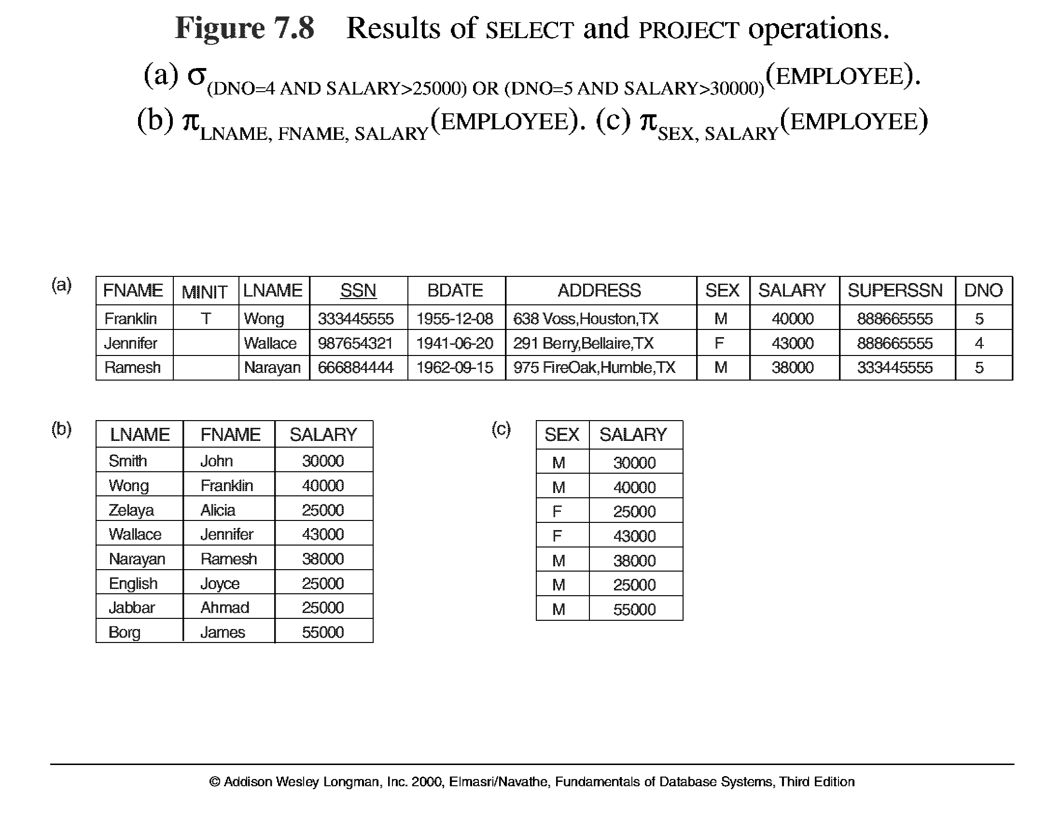
Unary Relational Operations (cont.)

Slide 26
Relational Model
PROJECT Operation
This operation selects certain columns from the table and discards the other columns. The PROJECT creates a vertical partitioning – one with the needed columns (attributes) containing results of the operation and other containing the discarded Columns.
A | B | C | D | E
1 | A | 212 | Y | 2
2 | C | 45 | N | 84
3 | B | 8656 | N | 4
4 | D | 324 | N | 56
5 | C | 5656 | Y | 34
6 | A | 445 | N | 4
7 | B | 546 | Y | 55

Slide 27

Project Operation
Example: To eliminate the branch_name attribute of account
∏_{account_number, balance} (account)
Example: To list each employee’s first and last name and salary, the following is used: ∏_{lname, fname, salary} (employee)
The general form of the project operation is π<attribute list>(R) where π (pi) is the symbol used to represent the project operation and <attribute list> is the desired list of attributes from the attributes of relation R.
Notation: where A₁, A₂ are attribute names and r is a relation name.
The result is defined as the relation of k columns obtained by erasing the columns that are not listed
The project operation removes any duplicate tuples, so the result of the project operation is a set of tuples and hence a valid relation.

Slide 28
Project Operation – Example
A
B
C
Relation r:
α
α
β
β
10
20
30
40
1
1
1
2
A
C
A
C
∏_{A,C} (r)
α
α
β
β
1
1
1
2
α
β
β
1
1
2
=

Slide 29
Relational Algebra

Slide 30
Unary Relational Operations (cont.)

Slide 31
Unary Relational Operations (cont.)
PROJECT Operation Properties
  The number of tuples in the result of projection π _{<list>} (R)is always less or equal to the number of tuples in R.
  If the list of attributes includes a key of R, then the number of tuples is equal to the number of tuples in R.
  π _{<list1>} (π _{<list2>} (R) ) = π _{<list1>} (R) as long as <list2> contains the attributes in <list2>

Slide 32
Rename Operation
Rename Operation
We may want to apply several relational algebra operations one after the other. Either we can write the operations as a single relational algebra expression by nesting the operations, or we can apply one operation at a time and create intermediate result relations. In the latter case, we must give names to the relations that hold the intermediate results.
Example: To retrieve the first name, last name, and salary of all employees who work in department number 5, we must apply a select and a project operation. We can write a single relational algebra expression as follows:
π_{FNAME, LNAME, SALARY}(σ _{DNO=5}(EMPLOYEE))
OR We can explicitly show the sequence of operations, giving a name to each intermediate relation:
DEP5_EMPS ← σ _{DNO=5}(EMPLOYEE)
RESULT ← π _{FNAME, LNAME, SALARY} (DEP5_EMPS)

Slide 33
Unary Relational Operations (cont.)
Rename Operation (cont.)
The rename operator is ρ
The general Rename operation can be expressed by any of the following forms:
ρ _{S (B1, B2, …, Bn )} ( R) is a renamed relation S based on R with column names B₁, B₁, …..B_{n}.
ρ _{S} ( R) is a renamed relation S based on R (which does not specify column names).
ρ _{(B1, B2, …, Bn )} ( R) is a renamed relation with column names B₁, B₁, …..B_{n} which does not specify a new relation name.

Slide 34
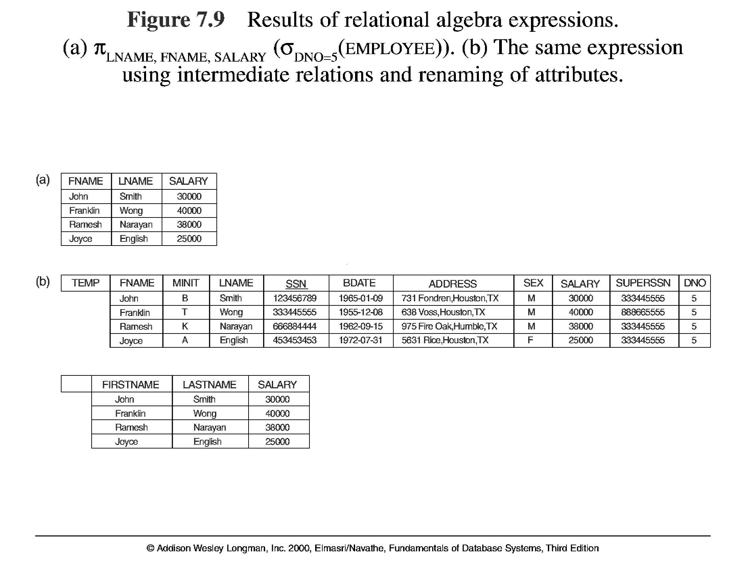
Unary Relational Operations (cont.)

Slide 35
Relational Algebra Operations From
Set Theory
Type Compatibility
  The operand relations R₁(A₁, A₂, ..., A_{n}) and R₂(B₁, B₂, ..., B_{n}) must have the same number of attributes, and the domains of corresponding attributes must be compatible; that is, dom(A_{i})=dom(B_{i}) for i=1, 2, ..., n.
  The resulting relation for R₁∪R₂,R₁∩R₂, or R₁-R₂ has the same attribute names as the first operand relation R1 (by convention).

Slide 36
Union Operation
UNION Operation
The result of this operation, denoted by R ∪ S, is a relation that includes all tuples that are either in R or in S or in both R and S. Duplicate tuples are eliminated.
Example: To retrieve the social security numbers of all employees who either work in department 5 or directly supervise an employee who works in department 5, we can use the union operation as follows:
DEP5_EMPS ← σ_{DNO=5} (EMPLOYEE)
RESULT1 ← π _{SSN}(DEP5_EMPS)
RESULT2(SSN) ← π _{SUPERSSN}(DEP5_EMPS)
RESULT ← RESULT1 ∪ RESULT2
The union operation produces the tuples that are in either RESULT1 or RESULT2 or both. The two operands must be “type compatible”.

Slide 37
Union Operation – Example
Relations r, s:
A
B
A
B
α
α
β
1
2
1
α
β
2
3
A
B
α
α
β
β
1
2
1
3
r ∪ s:
r
s
Example: to find all customers with either an account or a loan
∏customer_name (depositor) ∪ ∏customer_name (borrower)

Slide 38
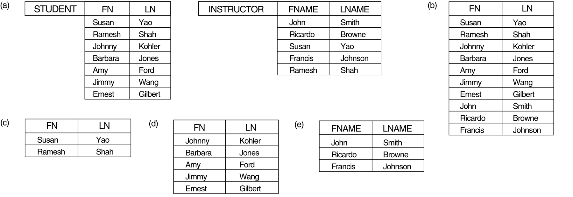
Union Operation – Example
UNION Example
STUDENT∪INSTRUCTOR

Slide 39
Intersection Operation
INTERSECTION OPERATION
The result of this operation, denoted by R ∩ S, is a relation that includes all tuples that are in both R and S. The two operands must be "type compatible"
Defined as r ∩ s = { t | t ∈ r and t ∈ s }
Assume:
  r, s have the same attribute
  attributes of r and s are compatible
Note: r ∩ s = r – (r – s)

Slide 40
Intersection Operation – Example
INTERSECTION Example
STUDENT ∩ INSTRUCTOR

Slide 41
Intersection Operation – Example
Relation r, s:
r ∩ s
A B
A B
α
α
β
1
2
1
α
β
2
3
r
s
A B
α 2

Slide 42
Set Difference Operation
The result of this operation, denoted by R - S, is a relation that includes all tuples that are in R but not in S. The two operands must be "type compatible”.
Notation r – s
Defined as:
r – s = {t | t ∈ r and t ∉ s}
Set differences must be taken between compatible relations.
  r and s must have the same arity
  attribute domains of r and s must be compatible

Slide 43
Set Difference – Example
Relations r, s:
A
B
A
B
α
α
β
1
2
1
α
β
2
3
s
r
r – s:
A
B
α
β
1
1

Slide 44
Set Difference – Example
STUDENT-INSTRUCTOR
INSTRUCTOR-STUDENT

Slide 45
Cartesian Operation
CARTESIAN (or cross product) Operation
  This operation is used to combine tuples from two relations in a combinatorial fashion. In general, the result of R(A₁, A₂, . . ., A_{n}) x S(B₁, B₂, . . ., B_{m}) is a relation Q with degree n + m attributes Q(A₁, A₂, . . ., A_{n}, B₁, B₂, . . ., B_{m}), in that order. The resulting relation Q has one tuple for each combination of tuples—one from R and one from S.
  Hence, if R has n_{R} tuples (denoted as |R| = n_{R} ), and S has n_{S} tuples, then
  | R x S | will have n_{R} * n_{S} tuples.
  The two operands do NOT have to be "type compatible”
  Assume that attributes of r(R) and s(S) are disjoint. (That is, R ∩ S = ∅).
  If attributes of r(R) and s(S) are not disjoint, then renaming must be used.

Slide 46
Cartesian-Product – Example
Relations r, s:
A
B
C
D
E
α
β
1
2
α
β
β
γ
10
10
20
10
a
a
b
b
r
s
r x s:
A
B
C
D
E
α
α
α
α
β
β
β
β
1
1
1
1
2
2
2
2
α
β
β
γ
α
β
β
γ
10
10
20
10
10
10
20
10
a
a
b
b
a
a
b
b

Slide 47
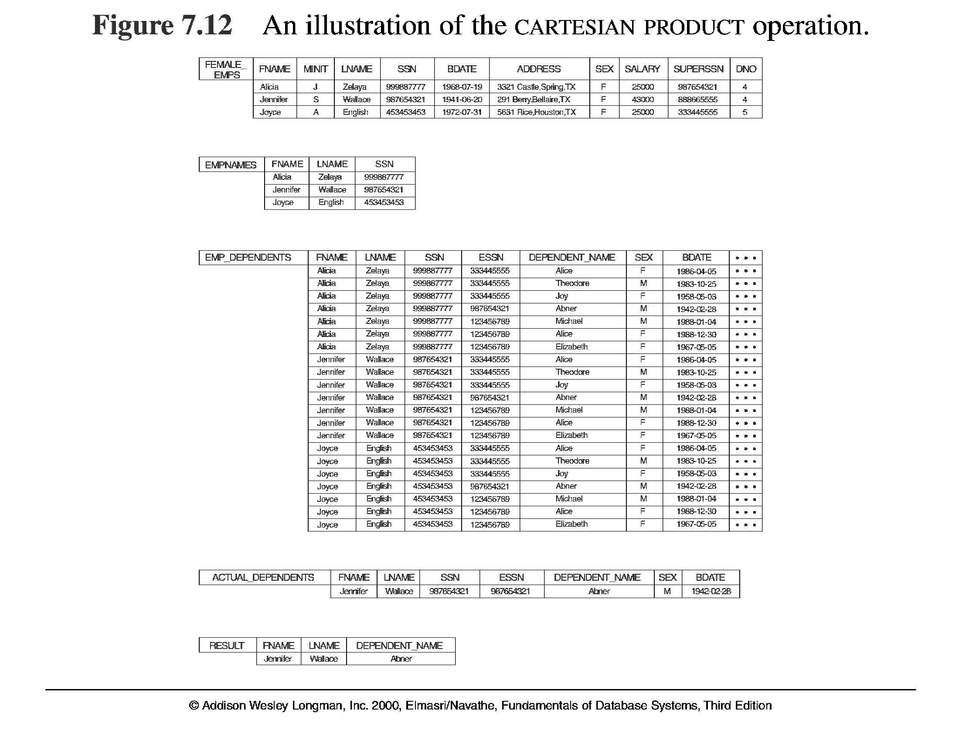
Example:
  FEMALE_EMPS ← σ _{SEX=’F’}(EMPLOYEE)
  EMPNAMES ← π _{FNAME, LNAME, SSN} (FEMALE_EMPS)
  EMP_DEPENDENTS ← EMPNAMES x DEPENDENT

Slide 48
Binary Relational Operations
JOIN Operation
  The sequence of cartesian product followed by select is used quite commonly to identify and select related tuples from two relations, a special operation, called JOIN. It is denoted by a
  This operation is very important for any relational database with more than a single relation, because it allows us to process relationships among relations.
  The general form of a join operation on two relations R(A₁, A₂, . . ., A_{n}) and S(B₁, B₂, . . ., B_{m}) is:
R _{<join condition>}S
where R and S can be any relations that result from general relational algebra expressions.

Slide 49
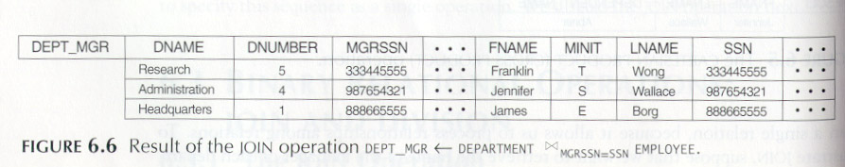
JOIN Operation (cont.)
Example: Suppose that we want to retrieve the name of the manager of each department. To get the manager’s name, we need to combine each DEPARTMENT tuple with the EMPLOYEE tuple whose SSN value matches the MGRSSN value in the department tuple. We do this by using the join operation.
DEPT_MGR ← DEPARTMENT _{MGRSSN=SSN} EMPLOYEE

Slide 50
JOIN Operation (cont.)
EQUIJOIN Operation (or Theta join)
The most common use of join involves join conditions with equality comparisons only. Such a join, where the only comparison operator used is =, is called an EQUIJOIN. In the result of an EQUIJOIN we always have one or more pairs of attributes (whose names need not be identical) that have identical values in every tuple.
The JOIN seen in the previous example was EQUIJOIN.
NATURAL JOIN Operation
The standard definition of natural join requires that the two join attributes, or each pair of corresponding join attributes, have the same name in both relations. If this is not the case, a renaming operation is applied first.
theta

Slide 51
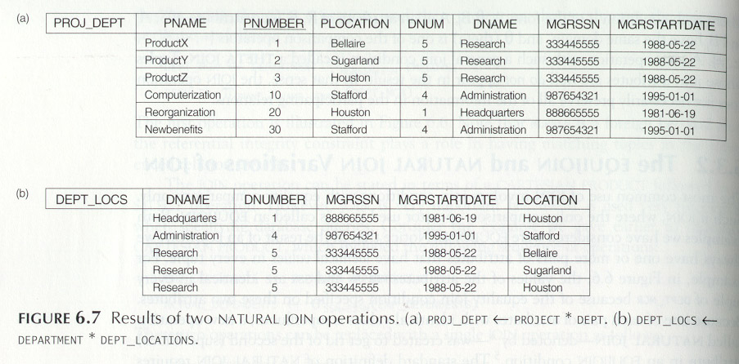
JOIN Operation (cont.)
Example: To apply a natural join on the DNUMBER attributes of DEPARTMENT and DEPT_LOCATIONS, it is sufficient to write:
DEPT_LOCS ← DEPARTMENT DEPT_LOCATIONS

Slide 52
Natural-Join Operation
Notation: r s
Let r and s be relations on schemas R and S respectively.
Then, r s is a relation on schema R ∪ S obtained as follows:
  Consider each pair of tuples t_{r} from r and t_{s} from s.
  If t_{r} and t_{s} have the same value on each of the attributes in R ∩ S, add a tuple t from the relation R X S to the result, where
    t has the same value as t_{r} on r
    t has the same value as t_{s} on s
Example:
  R = (A, B, C, D)
  S = (E, B, D)
  Result schema = (A, B, C, D, E)
  r s is defined as:
  ∏_{r.A, r.B, r.C, r.D, s.E} (σ_{r.B = s.B} ∧ _{r.D = s.D} (r x s))

Slide 53
Natural Join – Example
Relations r, s:
A
B
C
D
B
D
E
α
β
γ
α
δ
1
2
4
1
2
α
γ
β
γ
β
a
a
b
a
b
1
3
1
2
3
a
a
a
b
b
α
β
γ
δ
∈
r
s
r s
A
B
C
D
E
α
α
α
α
δ
1
1
1
1
2
α
α
γ
γ
β
a
a
a
a
b
α
γ
α
γ
δ

Slide 54
Additional Relational Operations
The OUTER JOIN Operation
  In NATURAL JOIN tuples without a matching (or related) tuple are eliminated from the join result. Tuples with null in the join attributes are also eliminated. This amounts to loss of information.
  A set of operations, called outer joins, can be used when we want to keep all the tuples in R, or all those in S, or all those in both relations in the result of the join, regardless of whether or not they have matching tuples in the other relation.
  The left outer join operation keeps every tuple in the first or left relation R in R S; if no matching tuple is found in S, then the attributes of S in the join result are filled or “padded” with null values.
  A similar operation, right outer join, keeps every tuple in the second or right relation S in the result of R S.
  A third operation, full outer join, denoted by keeps all tuples in both the left and the right relations when no matching tuples are found, padding them with null values as needed.

Slide 55
OUTER JOIN (cont.)
The outer union operation was developed to take the union of tuples from two relations if the relations are not union compatible.
This operation will take the union of tuples in two relations R(X, Y) and S(X, Z) that are partially compatible, meaning that only some of their attributes, say X, are union compatible.
The attributes that are union compatible are represented only once in the result, and those attributes that are not union compatible from either relation are also kept in the result relation T(X, Y, Z).
Example: An outer union to two schemas STUDENT(Name, SSN, Department, Advisor) and INSTRUCTOR(Name, SSN, Department, Rank).
  Tuples from the two relations are matched based on having the same combination of values of the shared attributes—Name, SSN, Department. If a student is also an instructor, both Advisor and Rank will have a value; otherwise, one of these two attributes will be null.
STUDENT_OR_INSTRUCTOR (Name, SSN, Department, Advisor, Rank)

Slide 56
Outer Join – Example
Relation loan
loan_number
branch_name
amount
L-170
L-230
L-260
Downtown
Redwood
Perryridge
3000
4000
1700
Relation borrower
customer_name
loan_number
Jones
Smith
Hayes
L-170
L-230
L-155

Slide 57
Outer Join – Example
Join
loan borrower
loan_number
branch_name
amount
customer_name
L-170
L-230
Downtown
Redwood
3000
4000
Jones
Smith
Left Outer Join
loan borrower
loan_number
branch_name
amount
customer_name
L-170
L-230
L-260
Downtown
Redwood
Perryridge
3000
4000
1700
Jones
Smith
null

Slide 58
Outer Join – Example
Right Outer Join
loan borrower
loan_number
branch_name
amount
customer_name
L-170
L-230
L-155
Downtown
Redwood
null
3000
4000
null
Jones
Smith
Hayes
Full Outer Join
loan borrower
loan_number
branch_name
amount
customer_name
L-170
L-230
L-260
L-155
Downtown
Redwood
Perryridge
null
3000
4000
1700
null
Jones
Smith
null
Hayes

Slide 59
Null Values
It is possible for tuples to have a null value, denoted by null, for some of their attributes
null signifies an unknown value or that a value does not exist.
The result of any arithmetic expression involving null is null.
Aggregate functions simply ignore null values (as in SQL)
For duplicate elimination and grouping, null is treated like any other value, and two nulls are assumed to be the same (as in SQL)

Slide 60
Null Values
Comparisons with null values return the special truth value: unknown
  If false was used instead of unknown, then not (A < 5)
  would not be equivalent to A >= 5
Three-valued logic using the truth value unknown:
  OR: (unknown or true) = true,
  (unknown or false) = unknown
  (unknown or unknown) = unknown
  AND: (true and unknown) = unknown,
  (false and unknown) = false,
  (unknown and unknown) = unknown
  NOT: (not unknown) = unknown
  In SQL “P is unknown” evaluates to true if predicate P evaluates to unknown
Result of select predicate is treated as false if it evaluates to unknown

Slide 61
Division Operation
r ÷ s
Notation:
Suited to queries that include the phrase “for all”.
Let r and s be relations on schemas R and S respectively where
  R = (A₁, …, A_{m} , B₁, …, B_{n} )
  S = (B₁, …, B_{n})
  The result of r ÷ s is a relation on schema
  R – S = (A₁, …, A_{m})
  r ÷ s = { t | t ∈ ∏ _{R-S} (r) ∧ ∀ u ∈ s ( tu ∈ r ) }
  Where tu means the concatenation of tuples t and u to produce a single tuple

Slide 62
Division Operation – Example
Relations r, s:
A
B
B
α
α
α
β
γ
δ
δ
δ
∈
∈
β
1
2
3
1
1
1
3
4
6
1
2
1
2
s
r ÷ s:
A
r
α
β

Slide 63
Another Division Example
Relations r, s:
A
B
C
D
E
D
E
α
α
α
β
β
γ
γ
γ
a
a
a
a
a
a
a
a
α
γ
γ
γ
γ
γ
γ
β
a
a
b
a
b
a
b
b
1
1
1
1
3
1
1
1
a
b
1
1
s
r
r ÷ s:
A
B
C
α
γ
a
a
γ
γ

Slide 64
Division Operation (Cont.)
Property
  Let q = r ÷ s
  Then q is the largest relation satisfying q x s ⊆ r
Definition in terms of the basic algebra operation
Let r(R) and s(S) be relations, and let S ⊆ R
r ÷ s = ∏_{R-S} (r ) – ∏_{R-S} ( ( ∏_{R-S} (r ) x s ) – ∏_{R-S,S}(r ))
To see why
  ∏_{R-S,S} (r) simply reorders attributes of r
  ∏_{R-S} (∏_{R-S} (r ) x s ) – ∏_{R-S,S}(r) ) gives those tuples t in
  ∏_{R-S} (r ) such that for some tuple u ∈ s, tu ∉ r.

Slide 65
Assignment Operation
The assignment operation (←) provides a convenient way to express complex queries.
  Write query as a sequential program consisting of
    a series of assignments
    followed by an expression whose value is displayed as a result of the query.
  Assignment must always be made to a temporary relation variable.
Example: Write r ÷ s as
temp1 ← ∏_{R-S} (r )
temp2 ← ∏_{R-S} ((temp1 x s ) – ∏_{R-S,S} (r ))
result = temp1 – temp2
  The result to the right of the ← is assigned to the relation variable on the left of the ←.
  May use variable in subsequent expressions.

Slide 66
Composition of Operations
Can build expressions using multiple operations
Example: σ_{A=C}(r x s)
r x s
σ_{A=C}(r x s)
A
B
C
D
E
α
α
α
α
β
β
β
β
1
1
1
1
2
2
2
2
α
β
β
γ
α
β
β
γ
10
10
20
10
10
10
20
10
a
a
b
b
a
a
b
b
A
B
C
D
E
α
β
β
1
2
2
α
β
β
10
10
20
a
a
b

Slide 67
Banking Example
branch (branch_name, branch_city, assets)
customer (customer_name, customer_street, customer_city)
account (account_number, branch_name, balance)
loan (loan_number, branch_name, amount)
depositor (customer_name, account_number)
borrower (customer_name, loan_number)
Find all loans of over $1200.
Find the loan number for each loan of an amount greater than $1200.
Find the names of all customers who have a loan, an account, or both, from the bank.
Find the names of all customers who have a loan at the Perryridge branch.
Find the names of all customers who have a loan at the Perryridge branch but do not have an account at any branch of the bank.
Find the names of all customers who have a loan at the Perryridge branch.
Find the largest account balance.

Slide 68
Modification of the Database
The content of the database may be modified using the following operations:
  Deletion
  Insertion
  Updating
All these operations are expressed using the assignment operator.

Slide 69
Deletion
A delete request is expressed similarly to a query, except instead of displaying tuples to the user, the selected tuples are removed from the database.
Can delete only whole tuples; cannot delete values on only particular attributes
A deletion is expressed in relational algebra by:
r ← r – E
where r is a relation and E is a relational algebra query.

Slide 70
Deletion Examples
Delete all account records in the Perryridge branch.
account ← account – σ _{branch_name = “Perryridge”} (account )
Delete all loan records with amount in the range of 0 to 50
loan ← loan – σ _{amount ≥ 0 and amount ≤ 50} (loan)
Delete all accounts at branches located in Needham.
r₁ ← σ _{branch_city = “Needham”} (account branch )
r₂ ← ∏ _{account_number,} _{branch_name, balance} (r₁)
r₃ ← ∏ _{customer_name, account_number} (r₂ depositor)
account ← account – r₂
depositor ← depositor – r₃

Slide 71
Insertion
To insert data into a relation, we either:
  specify a tuple to be inserted
  write a query whose result is a set of tuples to be inserted
in relational algebra, an insertion is expressed by:
r ← r ∪ E
where r is a relation and E is a relational algebra expression.
The insertion of a single tuple is expressed by letting E be a constant relation containing one tuple.

Slide 72
Insertion Examples
Insert information in the database specifying that Smith has $1200 in account A-973 at the Perryridge branch.
account ← account ∪ {(“A-973”, “Perryridge”, 1200)}
depositor ← depositor ∪ {(“Smith”, “A-973”)}
Provide as a gift for all loan customers in the Perryridge
branch, a $200 savings account. Let the loan number serve
as the account number for the new savings account.
r₁ ← (σ_{branch_name = “Perryridge”} (borrower loan))
account ← account ∪ ∏_{loan_number, branch_name, 200} (r₁)
depositor ← depositor ∪ ∏_{customer_name, loan_number} (r₁)

Slide 73

Updating
A mechanism to change a value in a tuple without charging all values in the tuple
Use the generalized projection operator to do this task
Each F_{i} is either
  the I ^{th} attribute of r, if the I ^{th} attribute is not updated, or,
  if the attribute is to be updated F_{i} is an expression, involving only constants and the attributes of r, which gives the new value for the attribute

Slide 74
Update Examples
Make interest payments by increasing all balances by 5 percent.
account ← ∏ account_number, branch_name, balance * 1.05 (account)
Pay all accounts with balances over $10000, 6 percent interest
and pay all others 5 percent
account ← ∏ account_number, branch_name, balance * 1.06 (σ _{BAL > 10000} (account ))
∪ ∏ account_number, branch_name, balance * 1.05 (σ_{BAL ≤ 10000} (account))

